Slide 1
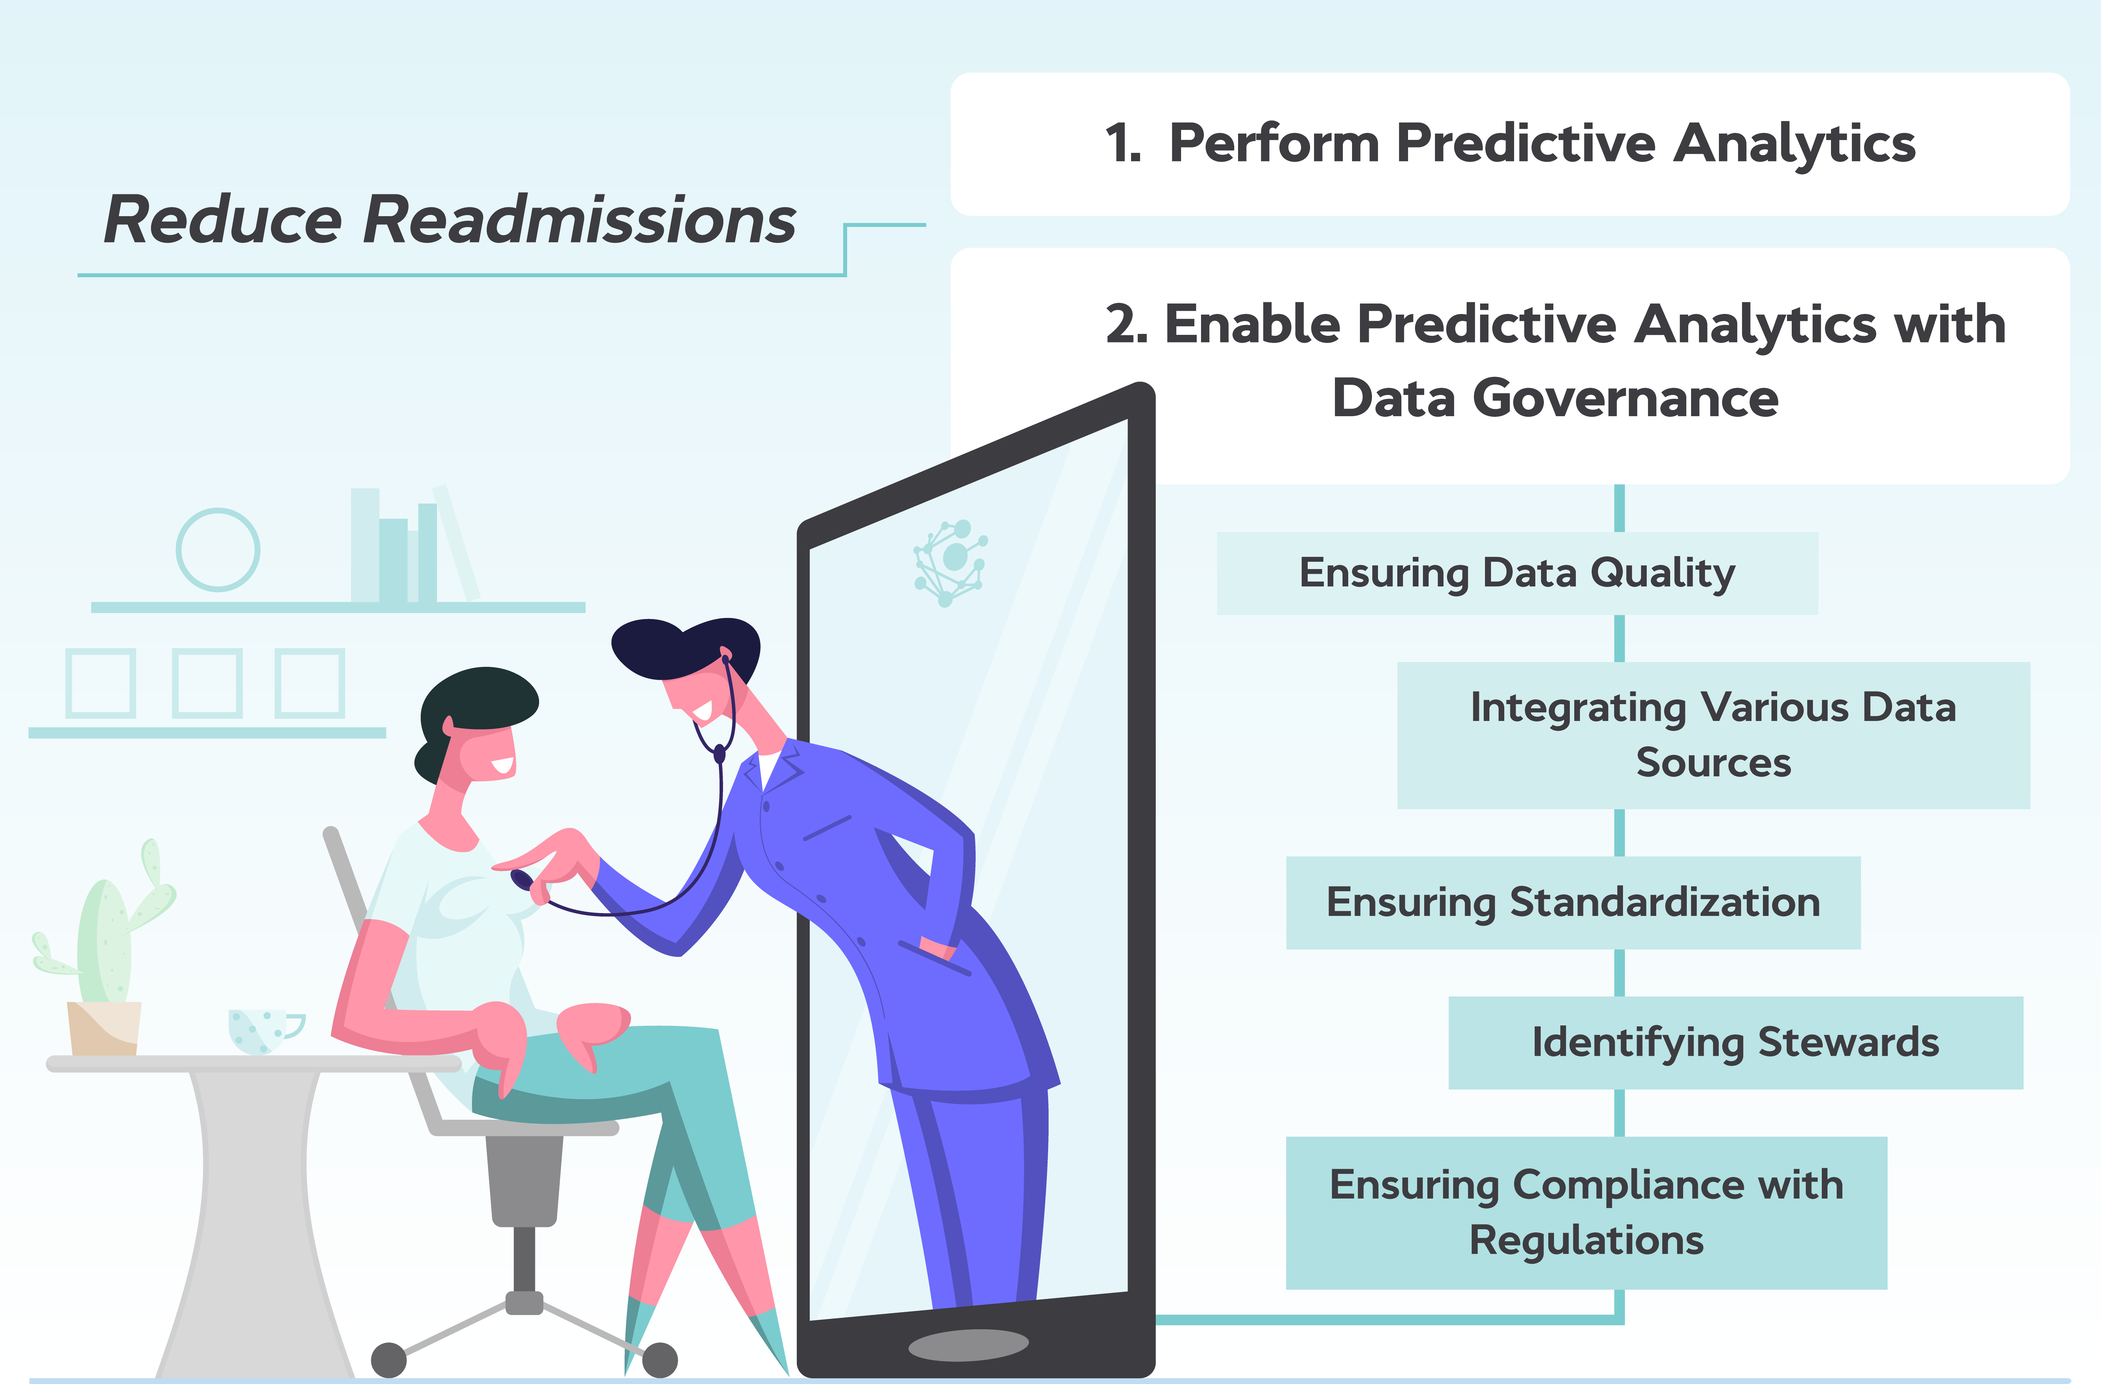
Predicting Hospital Readmission Risk

Slide 2

Understanding the Problem Statement
Problem Statement: Predict hospital readmission risk for patients with chronic conditions.
Background: Hospital readmissions are a significant challenge for healthcare systems, particularly for patients suffering from chronic illnesses.
Importance of Early Identification: Recognizing patients at high risk for readmission allows for timely interventions.

Slide 3
Key Risk Factors and Trends
1.Key risk factors affecting readmission rates include patient demographics, medical history, and socioeconomic factors.
2.Patient demographics such as age and gender play a significant role in readmission rates.
3.Medical history, including previous admissions and comorbidities, affects readmission likelihood.
Socioeconomic factors like income and education level impact patient health outcomes.
Trends in hospital readmissions have changed over time, reflecting healthcare improvements.
Monitoring these risk factors is essential for healthcare providers.

Slide 4

Data Set Overview
Data set used for analysis: Healthcare Dataset from Kaggle
Description of the dataset
Relevance to the analysis of hospital readmissions

Slide 5
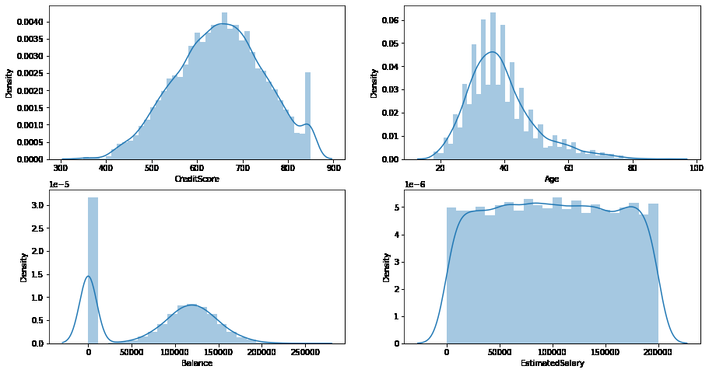
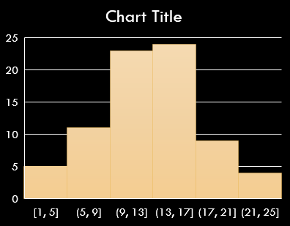
Data Preprocessing and Visualization
This process is crucial because real-world data frequently contains inconsistencies, errors, missing values, and irrelevant information.

Slide 6

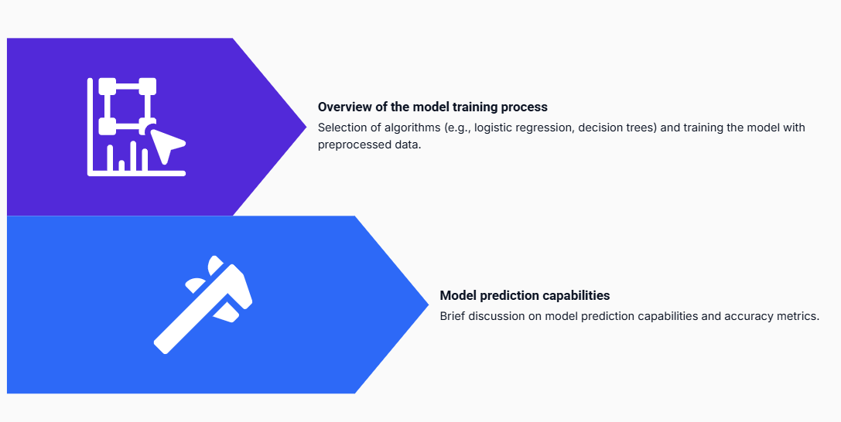
Model Training and Prediction

Slide 7
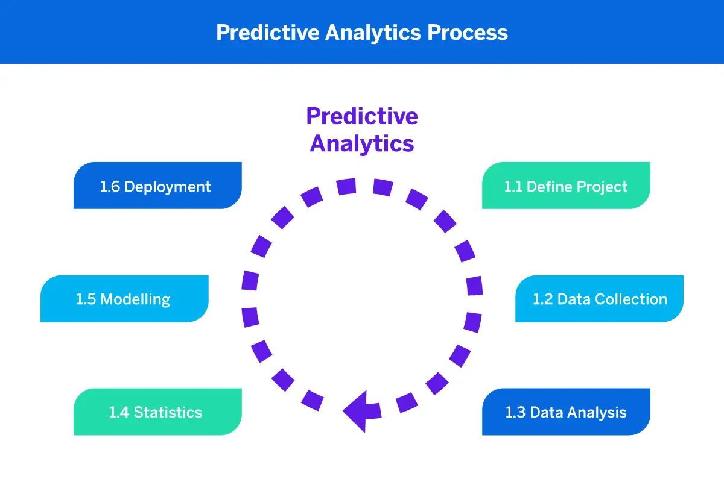
Key Factors for Prediction
Factors considered for predicting patient outcomes:
Clinical indicators, patient history and demographics, and social determinants of health are essential in assessing risk.
Analyzing trends and patterns in readmission data
Visualizing data helps in understanding factors leading to readmissions.
Importance of a comprehensive approach to risk assessment.
A holistic evaluation leads to better prediction of hospital readmission risk.

Slide 8
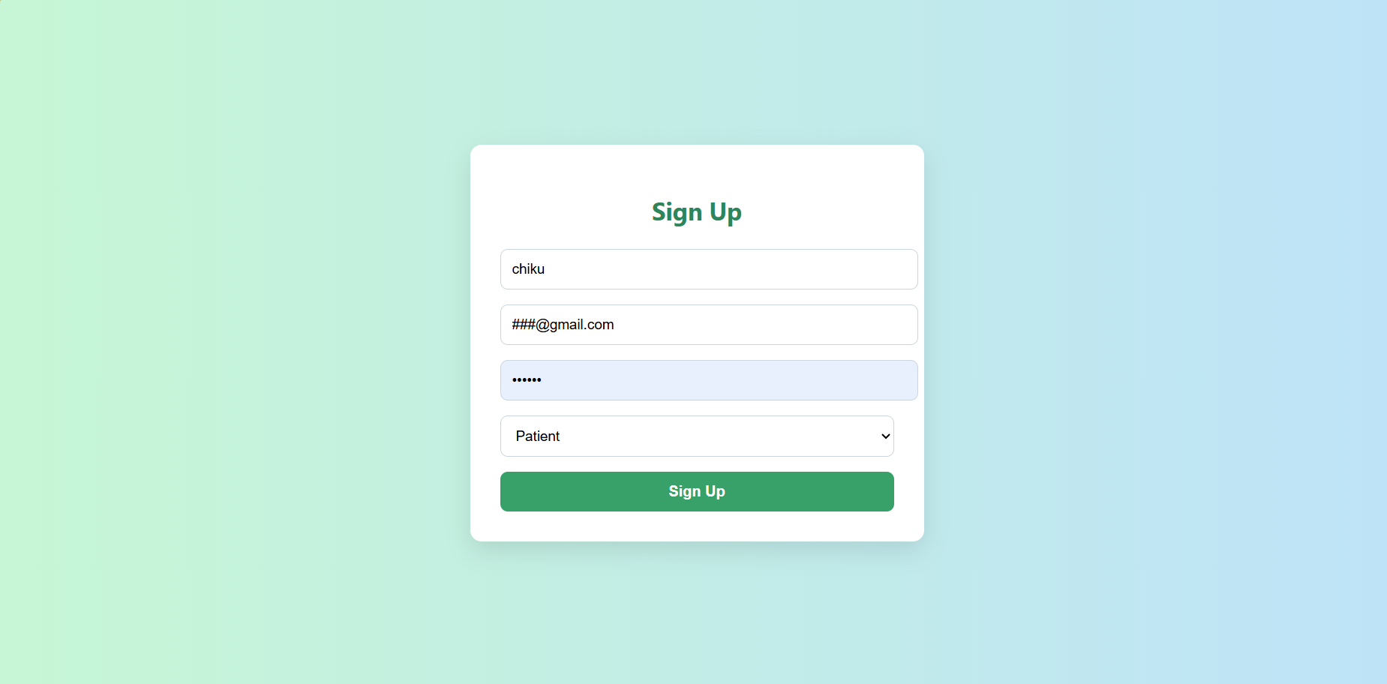
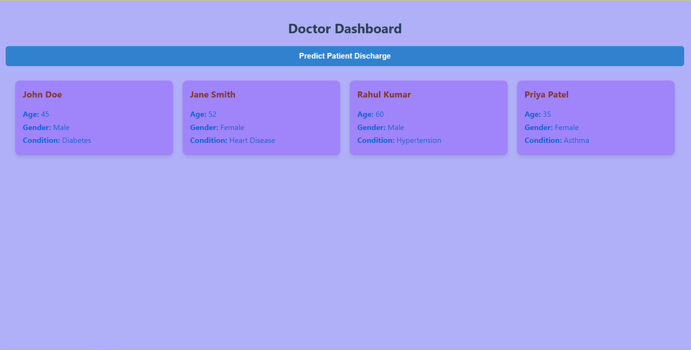
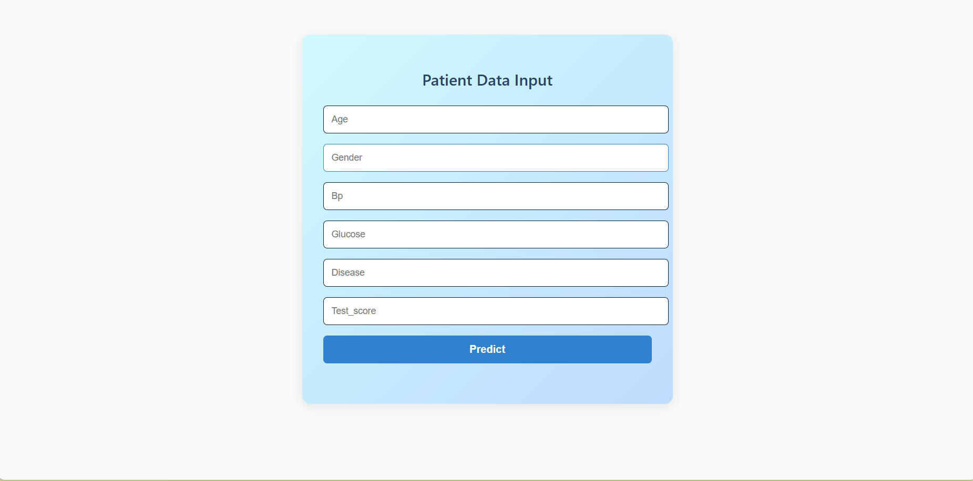
Frontend Web Application UI
Interactive elements for patient data input
Overview of the user interface for the web application developed:
Features for healthcare providers to access risk prediction results
This section provides a comprehensive look at the design and functionality of the web application's interface, tailored for healthcare providers and patient interactions.
Healthcare providers can conveniently view and interpret risk prediction outcomes through the application interface.
The application includes user-friendly interactive elements that allow patients to enter their data seamlessly.

Slide 9
Let’s enhance usability and accuracy in hospital readmission predictions.
thank you
Subhrajit Das(23cse658)
Badal padhy(23cse139)
pappu kumar(23cse608)
Rahul bisoyi(23cse400)

